Slide 1
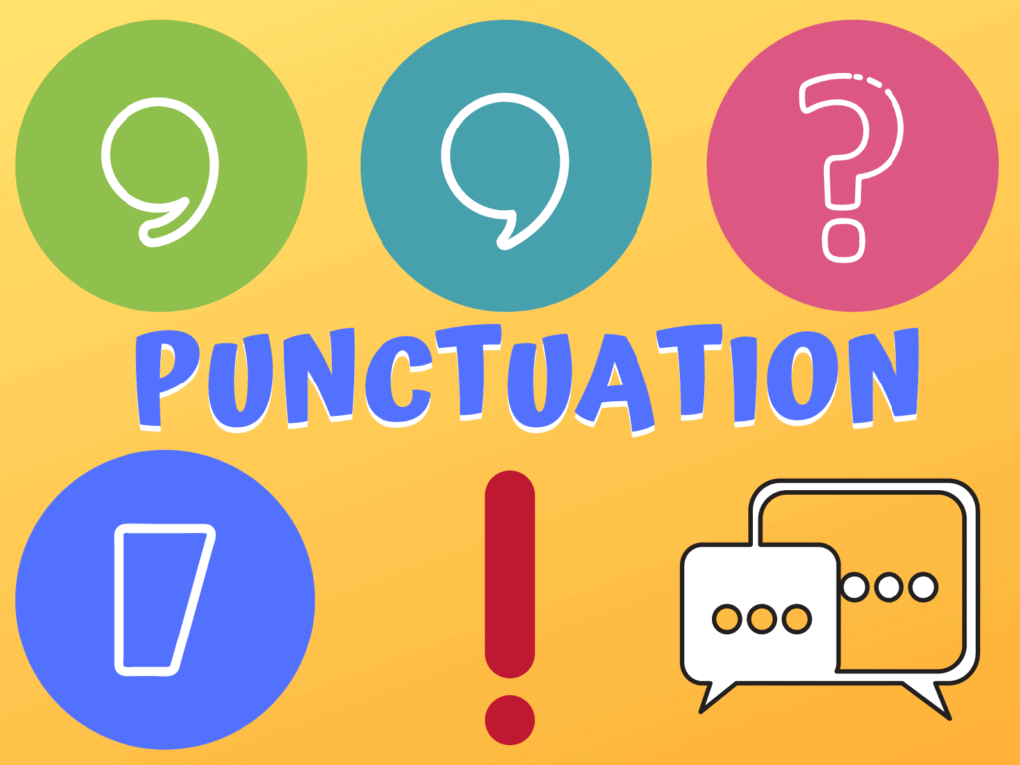
Basic Punctuation Rules
By
Ms. Farzana Khan
4-1

Slide 2
The set of marks used to regulate texts and clarify their meanings, principally by separating or linking words, phrases, clauses and sentences.

Slide 3
Sentence
That that is is
That that is not is not
Is that it It is
Let’s eat Grandma.

Slide 4
Sentence
That that is, is.
That that is not, is not.
Is that it? It is.
Let’s eat, Grandma!

Slide 5


Contents
End Marks
Capital letters
Apostrophes
Semicolons
Brackets
Dashes
Commas
Speech Marks
5 of 46
© Boardworks Ltd 2006

Slide 6
End Marks
Full stop
Question Mark
Exclamation Mark

Slide 7
1.The full stop The Full Stop represents the greatest pause and separation. It is used to mark the end of an assertive or an imperative sentence
It is raining today.
Do not interrupt while I am talking.
Source: http://grammar.ccc.commnet.edu/grammar/ppt

Slide 8
2.A question mark means something is being asked.
Are you going to lunch?
3.An exclamation mark shows excitement or strong
Feeling.
That is a huge building!
Source: http://grammar.ccc.commnet.edu/grammar/ppt

Slide 9

CAPITAL LETTER

Slide 10
1.Capitalize the first word of every sentence

Slide 11
2.In titles, headings and subheadings capitalize the first, last, and all important words.
Upper lower case
Usually, we don’t capitalize articles, prepositions, helping verb and conjunctions.
Pakistan is Rich in Resources

Slide 12
3.Capitalize names of specific persons, places, and geographical locations(proper noun).
My brother Waqas, who used to live in the Middle East and write books about the Old West, now lives in Australia.
Don’t capitalize directions, colours and names of seasons
but
They have reached north of the Indian Ocean.
Next fall, before the winter storms begin, we’re heading south.
There are very few blacks in this predominantly white community

Slide 13
4.Capitalize names of days of the week, months, and holidays.
Pakistan Independence Day which is always on Agust14, falls on Tuesday this year.
Pronoun “I”

Slide 14
5.Capitalize the names of historical events.
The Battle of the Bulge was an important event in World War II.
The Reformation took place in the sixteenth century.
6.Capitalize the names of religions and religious terms.
and
God, Christ, Allah, Christianity, Christians, Jews, Islam, Muslims

Slide 15
7.Capitalize the names of nations, nationalities, and languages
Somalia, Swedish, English, Japanese , French ,
Urdu.

Slide 16
8.Capitalize the names of academic courses when they’re used as titles.
He is doing master in English.
and
9.Brand names . . . .
Oxford, Suzuki

Slide 17
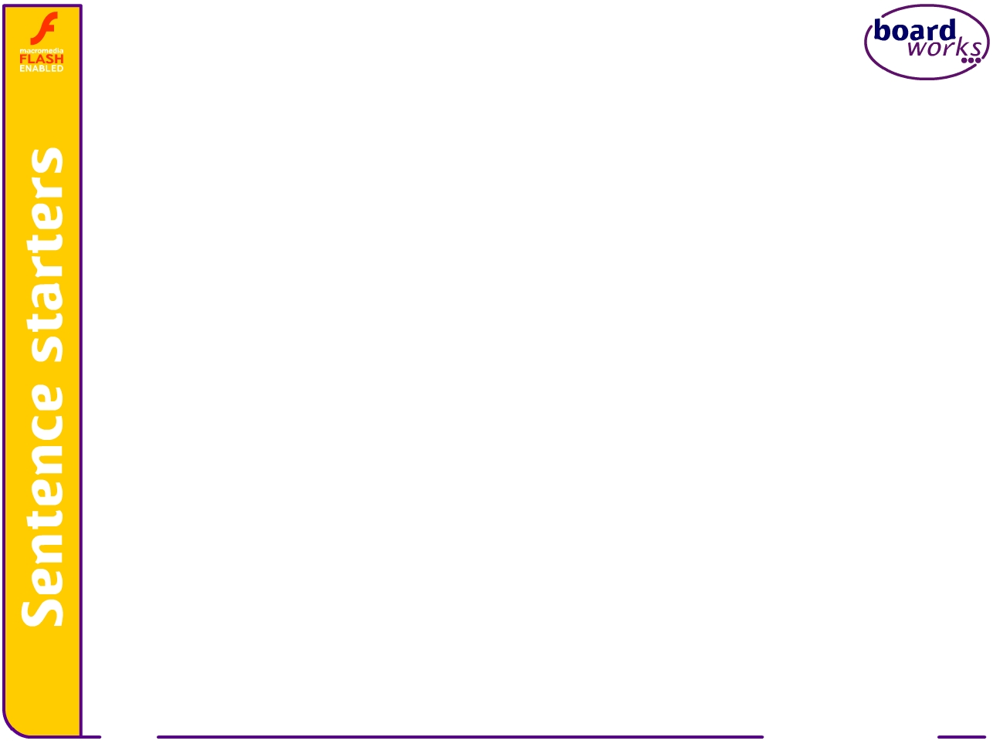
Apostrophes to show contractions
Apostrophe
17 of 46
© Boardworks Ltd 2006

Slide 18

Apostrophe’
Apostrophe (’) is the most commonly misused punctuation mark. They have three main uses. They show:
contractions
possession
unusual plurals
Contractions are shortened forms of words which have letters missing. The apostrophe is used in place of the missing letters, e.g.
It’s is short for It is.
We’ll is short for we will or we shall.
Can’t is short for cannot.
Notes:
It might be worthwhile to remind students that its is a determiner which shows possession and should not have an apostrophe in it.

Slide 19
Contractions
We use contractions a lot when we are speaking aloud because they save time and sound informal.
It’s It is
Can’t Can not
Contractions should be avoided in formal writing, such as in essays and letters, as they sound too chatty.
However, some writers use them when they write down the direct speech of a character or person.

Slide 20
Apostrophes to show possession
Apostrophes to show possession
20 of 46
© Boardworks Ltd 2006

Slide 21
Possession
Apostrophes are also used to show possession: who or what owns something, e.g.
This is Ali’s book belongs to Ali.
Adding an apostrophe and an s after a person, place or thing shows that he/she/it are the owner of the other noun in the sentence.

Slide 22

Possession
To show possession we normally add an apostrophe and an s after the word.
We don’t add the extra s, however, if the word is a plural noun because it already ends in an s, and it would become too difficult to pronounce, e.g.
1. Devices are selected from newspapers’ editorials
2. You only have two weeks’ holiday.
3. Those plants’ leaves are brown.
Notes:
It may be worth mentioning to the students that names which end with an ‘s’ are written in the apostrophe ‘s’ style if the possessive form is pronounced with an extra ‘s’, e.g.
The Jones’s front garden is wonderful.
However, if a name ending in ‘s’ is not pronounced with an extra ‘s’ in the possessive form, it will not be written with it, e.g.
Socrates’ philosophy.

Slide 23
Unusual plurals
The final use of apostrophe is to show unusual plurals, such as numbers and letters which would be unreadable otherwise, e.g.
Your mobile phone number is easy to remember because there are three 0’s in it.
My postcode has two B’s in it.
7 C’s of communication.
A’s

Slide 24
Colons
Colons
24 of 46
© Boardworks Ltd 2006

Slide 25
Colons :
The Colon mark a still more complete pause than that expressed by the Semicolon. It is used (sometimes with a dash after it): -
Before enumeration The fire destroyed many things in the house: the furniture, the carpets and the curtains
To introduce a quotation
Bacon says: “Reading makes a full man, writing an exact man, speaking a ready man.”

Slide 26
Colons
Here are some more examples of sentences with colons:
The fire destroyed many things in the house: the furniture, the carpets and the curtain
There are seven colours in the rainbow: red, orange, yellow, green, blue, indigo and violet.
Muhammad went shopping and bought some fruits: two apples, some cherries and a melon.

Slide 27
Semicolons
Semicolons
27 of 46
© Boardworks Ltd 2006

Slide 28
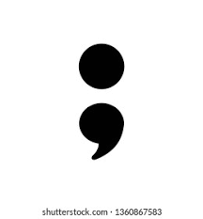
Semicolons
A semicolon (;) joins two complete sentences or two independent clauses into one sentence
This is because some sentences are too closely related to be separated by a full stop but they are missing a connecting word, such as and or but, e.g.

Slide 29
Semicolons
Here are some more examples of sentences with semicolons:
Muhammad was angry; Tamour was not listening.
Ali felt hot; the sun was blazing.
I found the film long; Tamour found the film short.
What does the semicolon imply in each sentence?
What would happen if the semicolons were replaced with colons or full stops?

Slide 30
Brackets
Brackets
30 of 46
© Boardworks Ltd 2006

Slide 31

Round Brackets
Brackets allow you to add extra information to a sentence, which is useful but not necessary or to add your opinion.
Speaking foreign languages (I believe) is a useful skill.
My parents ( Awais and Amna) are very strict.
The sentence still makes sense without the information in the brackets, e.g.
Speaking foreign languages is a useful skill.
My parents are very strict.

Slide 32
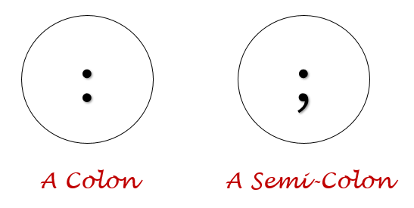
Difference between Colon and Semi Colon
Colons (:) are used in sentences to show that something is following, like a quotation, example, or list. Semicolons (;) are used to join two independent clauses, or two complete thoughts that could stand alone as complete sentences.
She kept repeating: “I really want that car!”
John was hurt; he knew she only said it to upset him.

Slide 33
Commas
Commas
33 of 46
© Boardworks Ltd 2006

Slide 34
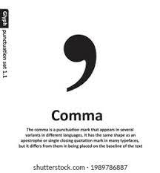
The Comma ,
1.The comma is used to separate a list.
Example: My favorite animals are giraffes, dogs, cats and birds.
2.It is also used between the date and the year.
Example: Today is March 6, 2007 and I plan to enjoy today.
3. A comma can also tell you where to pause in a sentence.
Example: All is well, but not necessarily forgotten.

Slide 35
The Comma ,
4.The comma is used between Words.
Example: You, he and I will buy the book.
I, you, and he will kill the man.
5.No use of comma when the order is S+V+O.
Example: Maha and Minahil bought books from the market near their house in the colony.
6. Comma is used when the order is broken.
Near their house in the colony, Maha and Minahil bought books.......

Slide 36
Speech marks
Speech marks
36 of 46
© Boardworks Ltd 2006

Slide 37
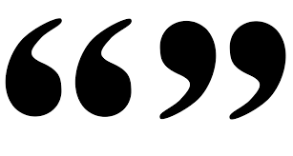
"Quotation Marks"
USE QUOTATION MARKS
To enclose every direct quotation and each part of an interrupted quotation:
To enclose chapter headings and the titles of articles:
Example: Dr Safder Mahmood, “Pakistan Ideology,” was recently reproduced in Journal.
Slides info source: http://grammar.ccc.commnet.edu/grammar/ppt

Slide 38
Punctuation Summary
Apostrophes are used to represent the missing letters in contractions (can’t) and to show possession
Colons help you to provide an explanation or example in one sentence.
Semicolons link two complete sentences to imply cause and effect
Brackets, dashes and pairs of commas all add extra information to sentences; their content is handy to know but is not vital
Put speech marks around direct speech.

Slide 39
winston is one of the most laid-back people he is tall and slim with black hair and he always wears a shirt and black jeans his jeans have holes in them and his baseball boots are scruffy too he usually sits at the back of the class and he often seems to be asleep when the exam results are given out he always gets an A i dont think hes as lazy as he appears to be

Slide 40
Winston is one of the most laid-back people . He is tall and slim with black hair, and he always wears a shirt and black jeans. His jeans have holes in them and his baseball boots are scruffy, too. He usually sits at the back of the class and he often seems to be asleep. When the exam results are given out he always gets an A. I don't think he's as lazy as he appears to be.

Slide 41
Use Appropriate Punctuation Marks
The fire has destroyed many things in the house, the furniture, the carpets and the curtains.
Some people work best in the mornings others do better in the evenings.
What are you doing next weekend.
Your mobile phone number is easy to remember because there are three 0 in it.
Mother had to go into hospital she had heart problems
Did you understand why I was upset.
We will be arriving on monday I think so morning at least
A textbook can be a wall between teacher and class
The girls father sat in a corner in Winter
In the words of Murphys law

Slide 42
Answers
The fire has destroyed many things in the house: the furniture, the carpets and the curtains.
Some people work best in the mornings; others do better in the evenings.
What are you doing next weekend?
Your mobile phone number is easy to remember because there are three 0’s in it.
Mother had to go into hospital; she had heart problems.
Did you understand why I was upset?
We will be arriving on Monday( I think so) morning at least.
A textbook can be a wall between teacher and class.
The girl’s father sat in a corner in winter.
In the words of Murphy’s Law.

